Slide 1
PDGAN Additional Information
Machine Learning Background

Slide 2
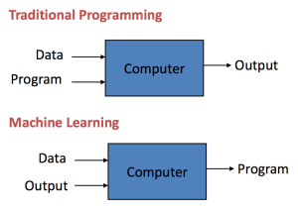
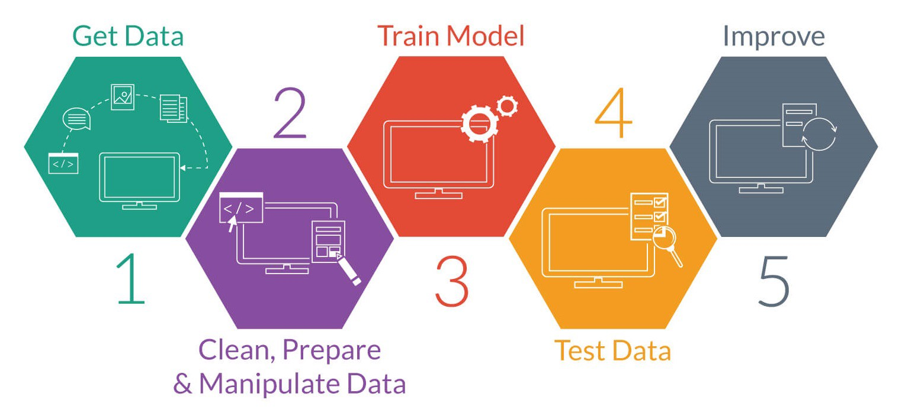
What is Machine Learning?
Machine Learning entails:
Forming Patterns from Data
Making Predictions based off Patterns

Slide 3
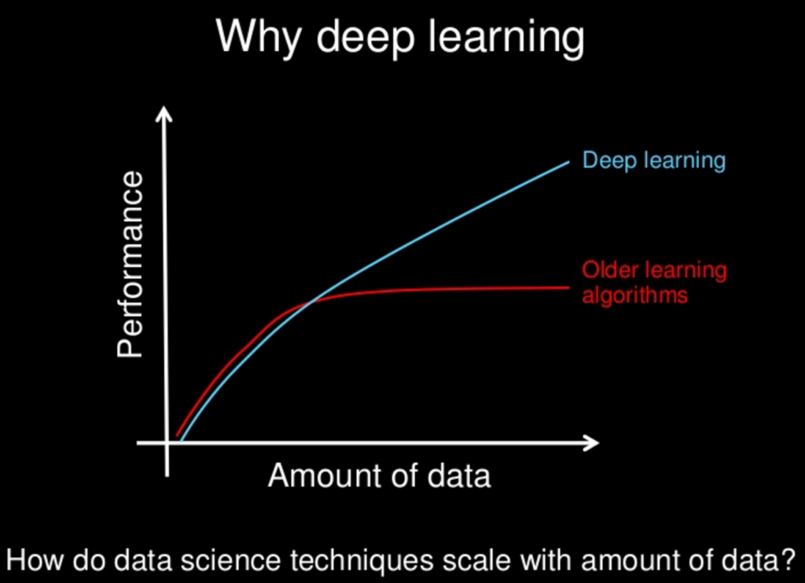
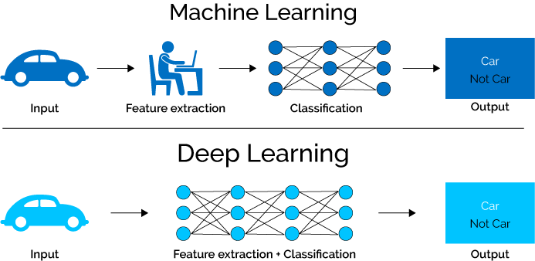
What is Deep Learning?
Deep Learning is a branch of Machine Learning that enables computers to process more complex patterns and finer differences in inputs. Deep Learning is essential for the intersection of ML and Medicine.

Slide 4
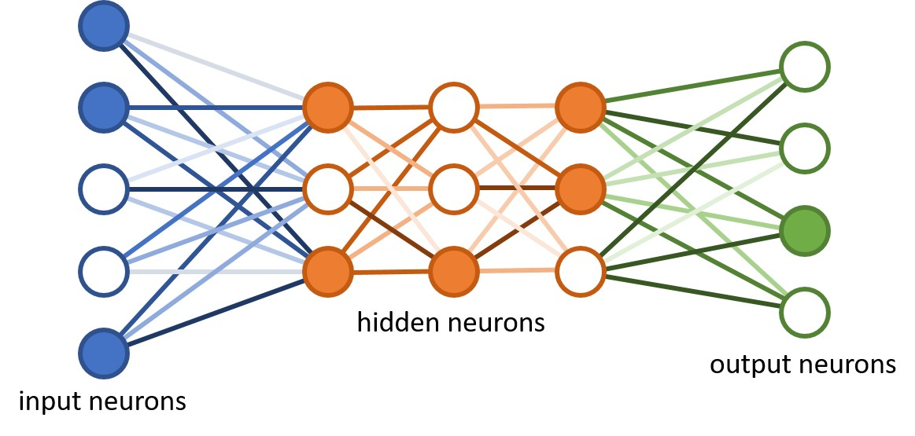
Neural Networks
Neural Networks are the most common Deep Learning model. They are modelled after how the brain makes decisions (through Neurons).

Slide 5
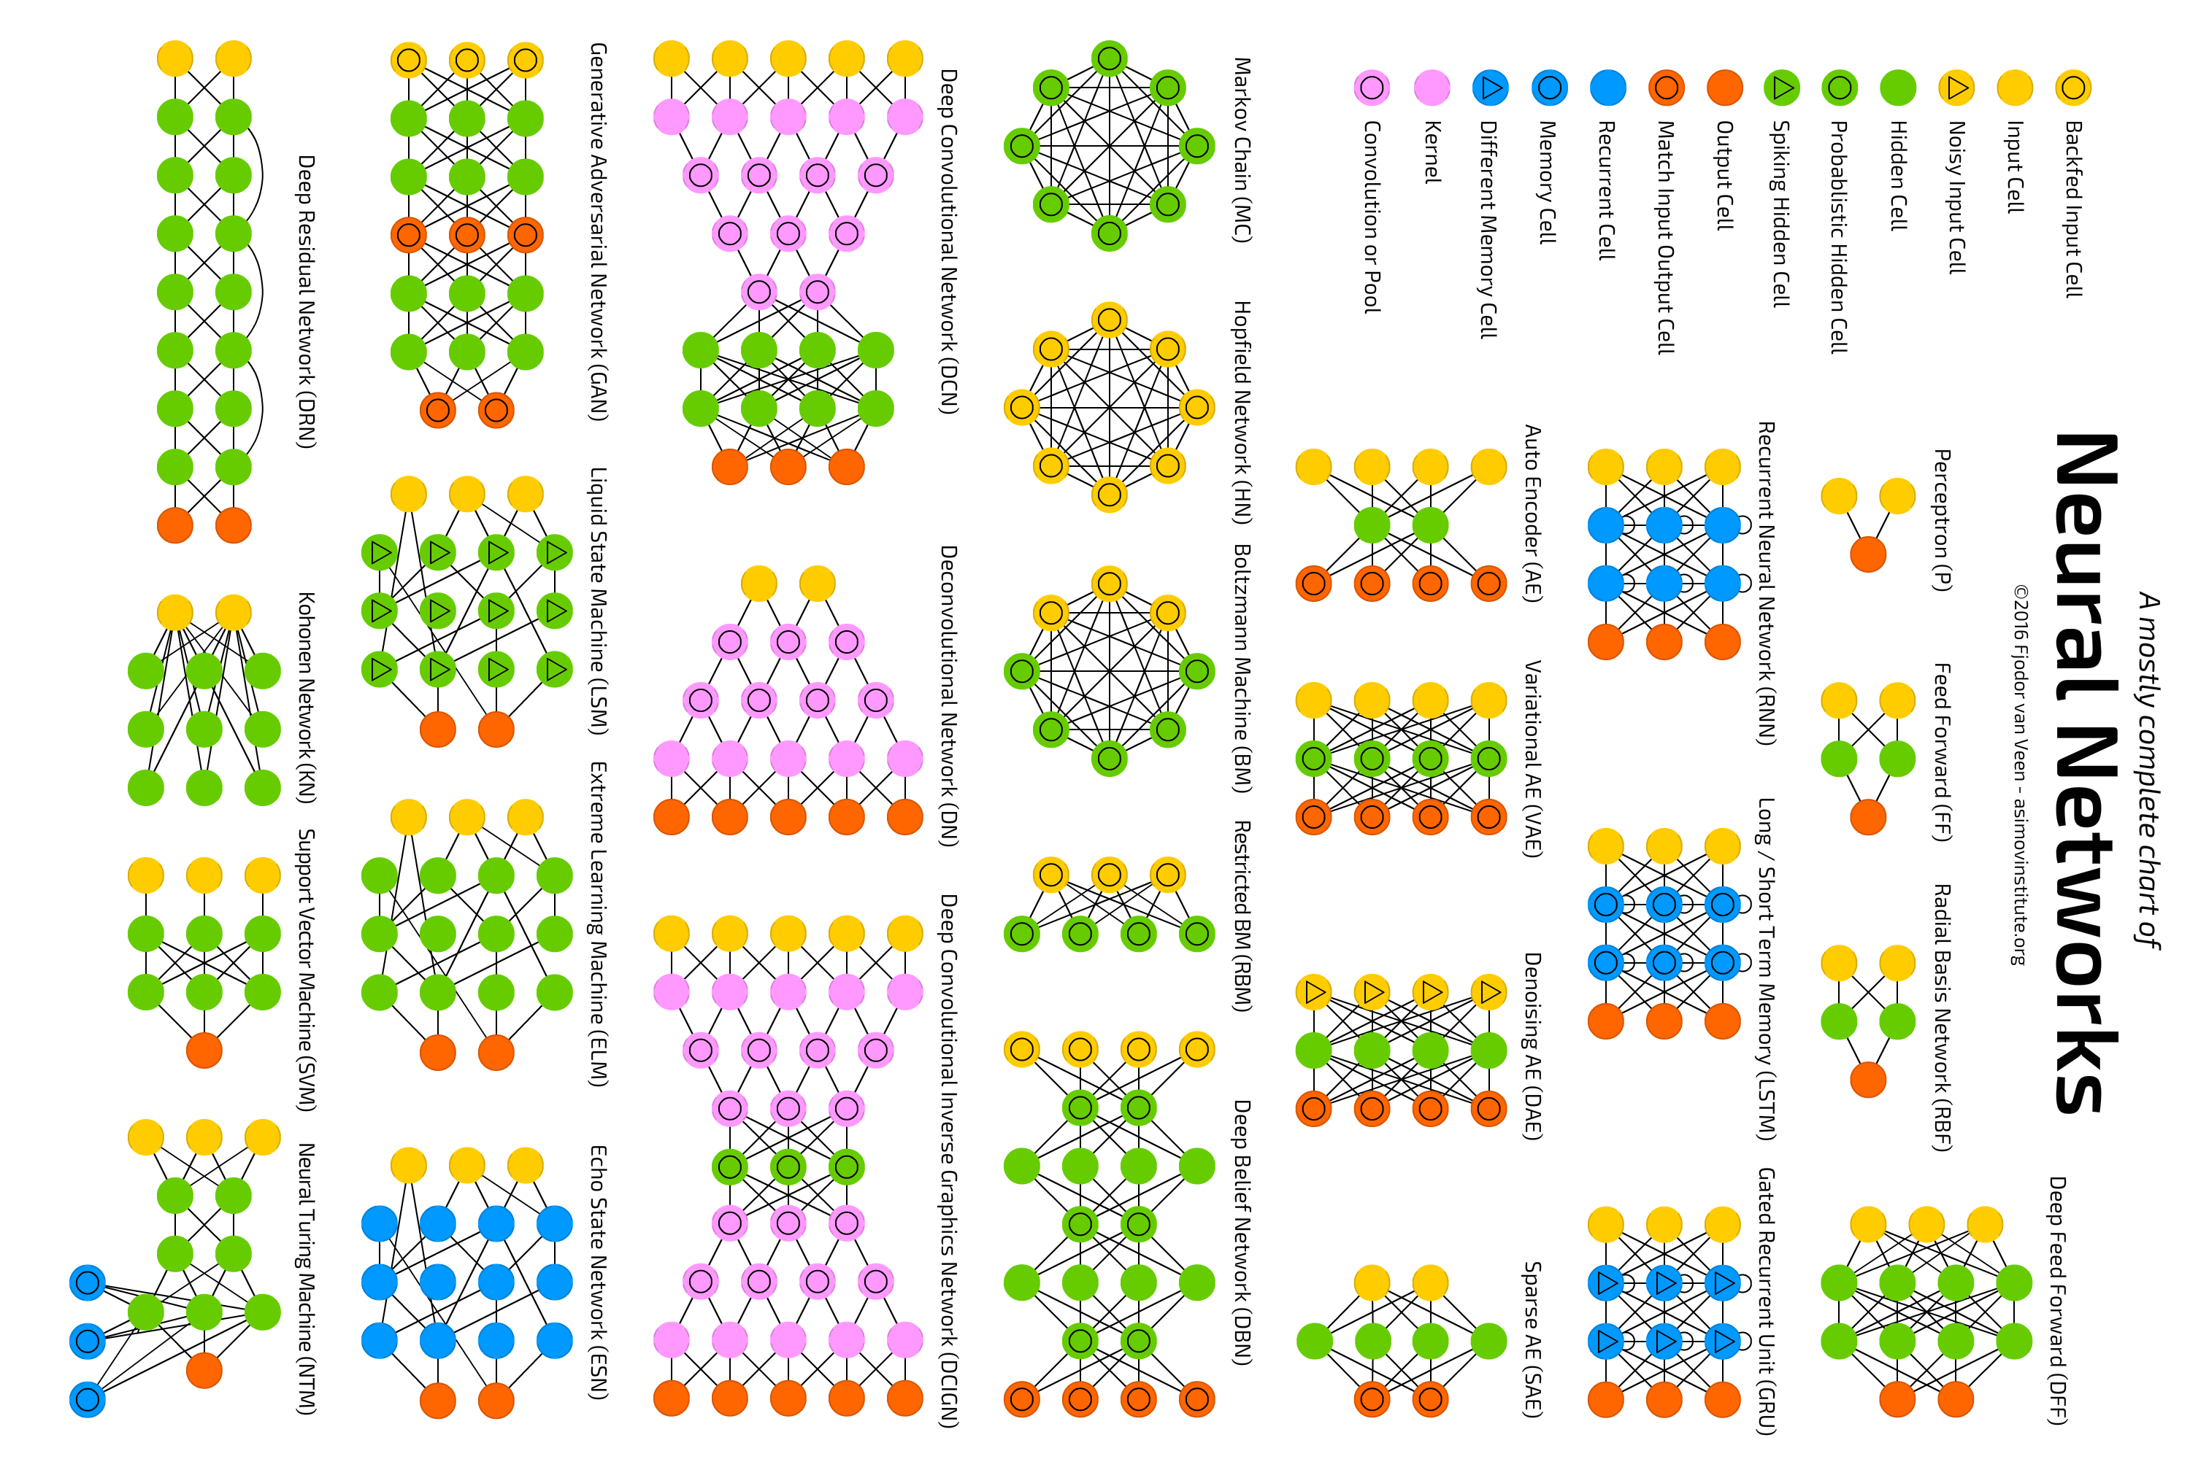

Slide 6
Machine Learning Process
Model
Output
Training
Training Data
Calculate Error
Expected Output
Fine-tune Model
Yes
Done!
Model
Output
Testing
Did the model do well enough?
Testing Data
Expected Output
Train More
No

Slide 7

Convolutional Neural Networks

Slide 8
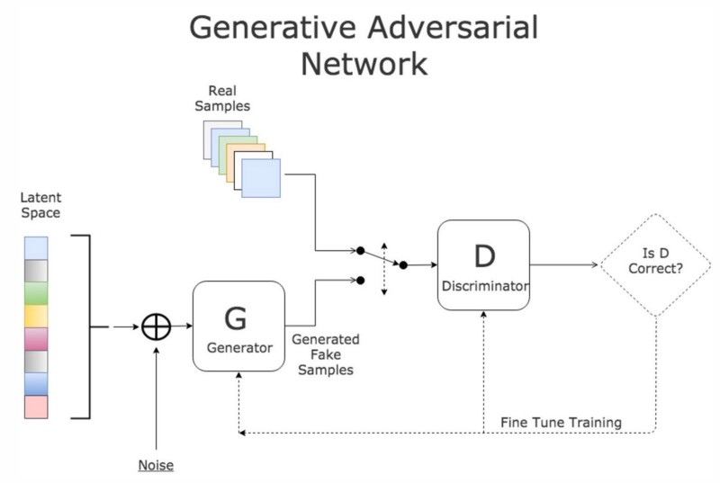
Generative Adversarial Networks
The Generator makes fake images.
The Discriminator determines if any random image is real or fake.
The Generator wants the Discriminator to do badly, so it tries to make realistic “fake” images.
Image Generation!

Slide 9
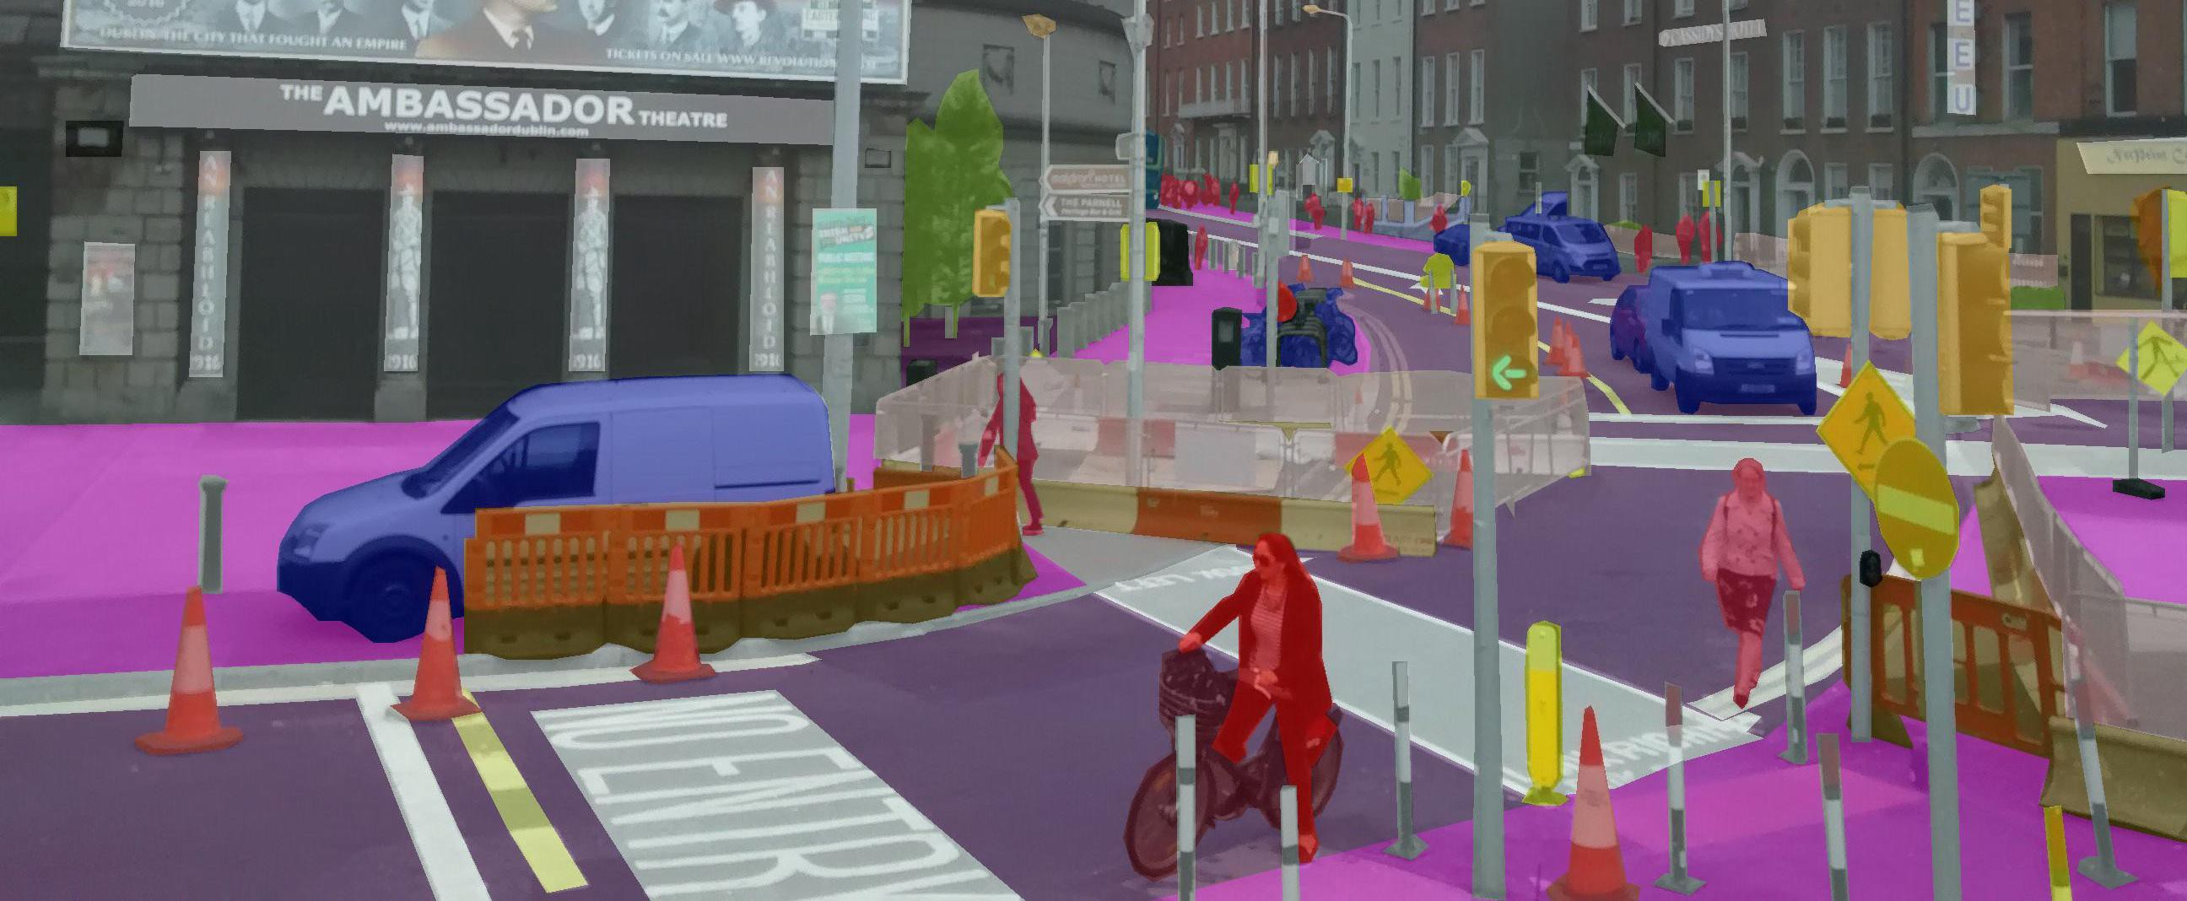
Segmentation Frameworks
Segmentation Frameworks work by highlighting parts of the image
In this example, each color is a different type of object (people, vehicles, etc.)
Typical Segmentation frameworks only have one color highlighting one important thing in the image

